Slide 1



COP24 Side Event
December 4, 2018
IFPRI, Cornell, CCAFS: Science and policy coming together for a sustainable contribution of agriculture to the NDCs and NAPs

Slide 2
Agenda
Welcome & Introductions: Allison Chatrchyan, Cornell University
  Tim Thomas: IFPRI, Washington, DC
  Angelina Espinoza, Ministry of Agriculture, Chile
  Carolina Balian, Ministry of Agriculture
  Diana Harutyunyan, UNDP Climate Change Program, Armenia
  Catherine Mungai, CCAFS East Africa
  Allison Chatrchyan, Cornell University
Questions and Answers and Discussion

Slide 3
Science and Policy Coming Together
Agriculture (including its effect on land use change) represents a significant component of the NDC in many countries. Yet to successfully implement the agricultural component of an NDC, policymakers need to better understand the likely impact of climate change on agriculture, as well as the potential savings in greenhouse gas (GHG) emissions from policy and investment options. There is also the issue of the possible tradeoff between mitigation and adaptation -- though Climate-Smart Agriculture (CSA) endeavors to find win-win options.
Science is able to provide valuable information to policymakers that can enable them to make better decisions in both short- and long-term planning. Yet there are challenges. Scientists sometimes have difficulty communicating relevant facts in understandable terms. And policymakers sometimes are challenged to communicate their questions in terms that scientists can meaningfully grapple with.
Experiences of scientists and policymakers dealing with science, policy, and the interaction of the two, in country plans to address climate change impacts to agriculture, and agriculture impacts to climate change. Presenters will represent the perspectives of several regions including Latin America, Africa, and the Caucasus, as well as academic institutions and international research institutes.

Slide 4
Impact of climate change on agriculture in Latin America
Timothy S. Thomas (IFPRI), Ana María Loboguerrero Rodriguez (CCAFS), Ana R. Rios (IDB), Deissy Martínez Barón (CCAFS), Graciella Magrin (Instituto Nacional de Tecnología Agropecuaria), and Vicente Barros (Universidad de Buenos Aires)

Slide 5

Acknowledgments
This work was undertaken as part of and jointly funded by
CGIAR Research Program on Climate Change, Agriculture and Food Security (CCAFS)
CGIAR Research Program on Policies, Institutions, and Markets (PIM).
The Bill & Melinda Gates Foundation (BMGF)
The Inter-American Development Bank (IDB)
The International Center for Tropical Agriculture (CIAT).
The opinions and views expressed here belong to the authors and may not be attributed to nor be taken to reflect the official opinions of BMGF, CCAFS, CGIAR, CIAT, IDB, IFPRI, PIM, or any of their respective donors or affiliates.

Slide 6
Overview
Multi-year study using biophysical and bioeconomic models to examine the effect of climate change on agriculture at both the national and pixel levels
Study area
  Five countries in Central America: Costa Rica, Guatemala, Honduras, Nicaragua, El Salvador
  Two Andean countries: Colombia and Peru
Condensing 700-pages to 8 minutes

Slide 7
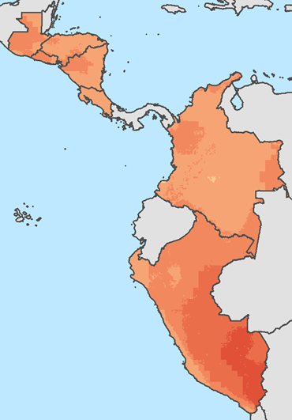
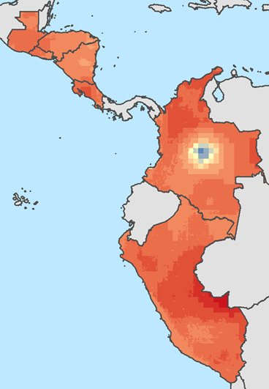
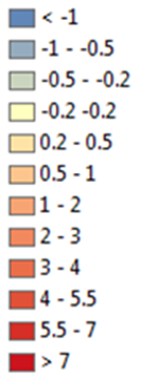
Climate Models: Temperature
Mean daily maximum temperature for the warmest month in ⁰C
GFDL-ESM2M
MIROC-ESM-CHEM
Source: Data from Müller and Robertson (2014), which used downscaled versions of four CMIP5 GCMs (Taylor, Stouffer, and Meehl 2012), under RCP8.5, and re-based to WorldClim 1.4 (Hijmans et al. 2005).
Notes:
We use 4 different climate models, but for the interest of space and time, I only show 2
*** Check the following values
Honduras GFDL 2.1 MIROC 4.1
Colombia GFDL 2.2 MIROC 3.1

Slide 8
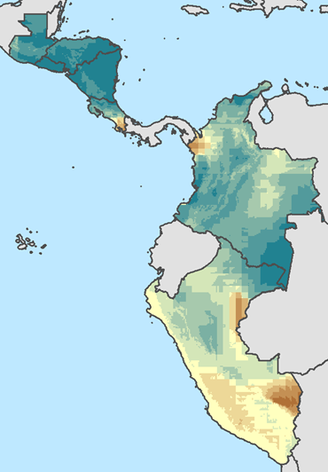
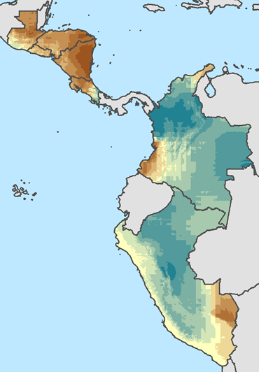
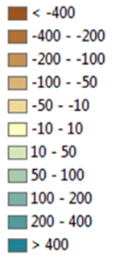
Climate Models: Precipitation
Annual precipitation in millimeters
GFDL-ESM2M
MIROC-ESM-CHEM
Source: Data from Müller and Robertson (2014), which used downscaled versions of four CMIP5 GCMs (Taylor, Stouffer, and Meehl 2012), under RCP8.5, and re-based to WorldClim 1.4 (Hijmans et al. 2005).
Notes:
GFDL Become much wetter in Central America, wetter in Colombia, and mixed in Peru
MIROC Much drier in Central America (3 of 4 models agree) and wetter in Andean region (3 of 4 models agree)

Slide 9
Rainfed maize yield changes due to climate change, 2000-2050
Country | GFDL | Had-GEM | IPSL | MIROC | Median of 4
Colombia | -8.3 | -8.5 | -23.1 | -8.0 | -8.4
Costa Rica | -7.1 | -8.4 | -14.5 | -5.0 | -7.8
Guatemala | -11.1 | -13.7 | -20.8 | -18.2 | -16.0
Honduras | -6.2 | -10.7 | -24.8 | -12.8 | -11.7
Nicaragua | -2.5 | -9.8 | -23.5 | -5.4 | -7.6
Peru | -1.6 | -5.0 | -10.3 | -10.0 | -7.5
El Salvador | -5.9 | -18.0 | -27.3 | -13.5 | -15.8
Source: Authors using composite of AgMIP GGCMI (Rosenzweig et al. 2014).
Notes:
AgMIP GGCMI

Slide 10
Crop Model Usage
Use four of seven models from AgMIP GGCMI
Analysis done using climate model data for 2050
Done for each half degree pixel (approximately 50 kilometers per side)
Assumes CO2 fertilization
Notes:
Agricultural Model Intercomparison and Improvement Project
Gridded Global Crop Model Intercomparison

Slide 11
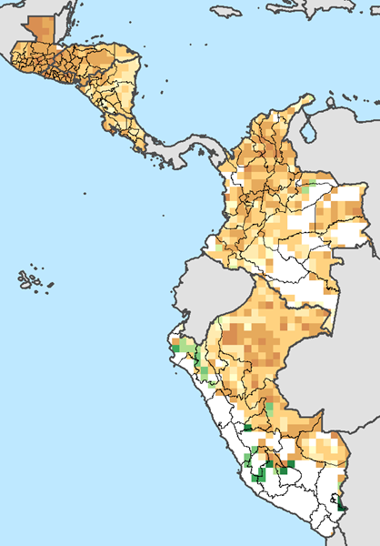
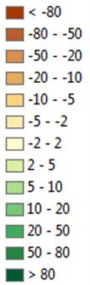
Median projections for rainfed maize
Source: Authors’ calculations based on data from the Agricultural Model Intercomparison and Improvement Project (AgMIP) Global Gridded Crop Model Intercomparison (GGCMI; see Rosenzweig et al. 2014).
Notes: The median at each pixel was computed from all possible combinations of four crop models and four climate models. All are from AGMIP GGCMI for Representative Concentration Pathway 8.5 (RCP8.5).

Slide 12
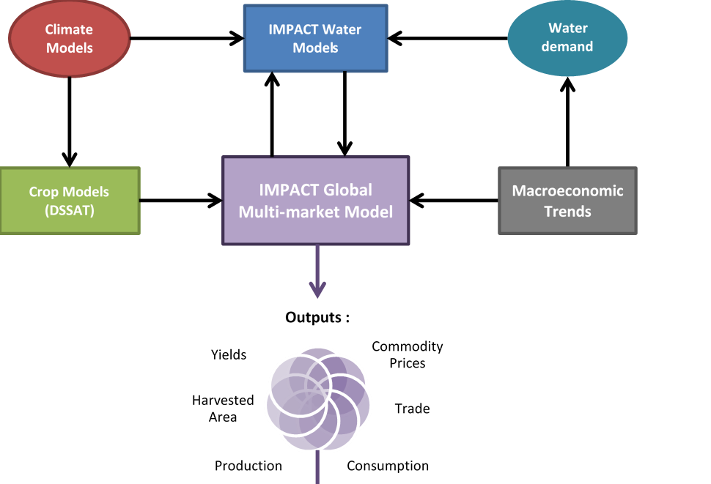
IMPACT Bioeconomic Model
159 countries, 154 water basins, 320 total units
39 crops, 6 livestock types, 17 processed foods
Post-solution models: nutrition and health, CGE model, land use
Source: Taken from Robinson et al. (2015).

Slide 13
Changes in maize yields, 2010-2050
 | Yield change, 2010 to 2050, ignoring climate change | Effect of climate change on yield, relative to no climate change, in 2050
Country |  | Median of 4 climate models | Minimum of 4 climate models | Maximum of 4 climate models
Costa Rica | 55.8 | -6.2 | -13.3 | -2.2
Guatemala | 72.2 | -13.5 | -18.5 | -10.8
Honduras | 67.1 | -9.4 | -21.7 | -6.3
Nicaragua | 84.1 | -7.1 | -18.7 | -4.1
El Salvador | 50.3 | -13.1 | -26.2 | -5.8
Colombia | 32.2 | -8.0 | -11.2 | -5.1
Peru | 49.6 | 5.8 | 5.0 | 6.0
Source: Authors using IMPACT model (Robinson et al. 2015).
Notes:
IMPACT Model

Slide 14
Production changes for 7 crops for the region (all 7 countries), 2010-2050
Crop | Yield, 2010 | % chg, 2010-2050, NoCC | % Diff, NoCC to Median, 2050 | Hec-tares har-vested, 2010 | % chg, 2010-2050, NoCC | % Diff, NoCC to Median, 2050 | Produc-tion, 2010 | % chg, 2010-2050, NoCC | % Diff, NoCC to Median, 2050
Maize | 2.13 | 53.9 | -5.1 | 2,806 | 32.1 | -1.3 | 5,990 | 103.4 | -6.3
Sugar cane | 97.27 | 27.4 | -27.6 | 1,008 | 54.1 | 14.5 | 98,046 | 96.2 | -17.2
Rice | 4.07 | 12.6 | 2.8 | 930 | -8.1 | 0.5 | 3,782 | 3.5 | 3.3
Beans | 0.89 | 50.9 | -11.8 | 825 | 43.2 | -3.4 | 737 | 116 | -14.8
Sorghum | 2.19 | 51.4 | -11.3 | 302 | 62.6 | 7.9 | 661 | 146.1 | -4.2
Oil palm | 18.38 | 24.2 | -1.1 | 365 | 45.8 | 0.0 | 6,709 | 81.1 | -1.1
Cassava | 11.32 | 57 | -3.7 | 299 | 18.7 | 1.6 | 3,383 | 86.3 | -2.2
Source: Authors using IMPACT model (Robinson et al. 2015).
Notes:
IMPACT Model

Slide 15
How might modeling help policy makers?
It gives policy makers an idea of the quantitative changes for multiple crops to help decide which are priorities for action
It shows ranges of uncertainty which help determine how flexible planning needs to be
It highlights sub-national regions which may need to receive special attention due to more severe impacts or to guide planning for projected land use changes
It may not go far enough in helping policy makers, and that is where feedback from potential users of data is very helpful

Slide 16
Final Notes
Printed 8-page project summary is available https://www.ifpri.org/publication/climate-change-and-agriculture-central-america-and-andean-region or go to ifpri.org and search “climate change Central America”
Detailed country reports (70 to 100 pages each) are being published, and should be online by the end of the year https://www.ifpri.org/country/central-america

Slide 17
“Science and Policy Coming Together for a sustainable contribution of agriculture to the Nationally Determined Contributions (NDCs) & National Adaptation Plans”
Contribución de la agricultura al NDC de Chile
4 Diciembre 2018
COP24
Katowice, Polonia

Slide 18
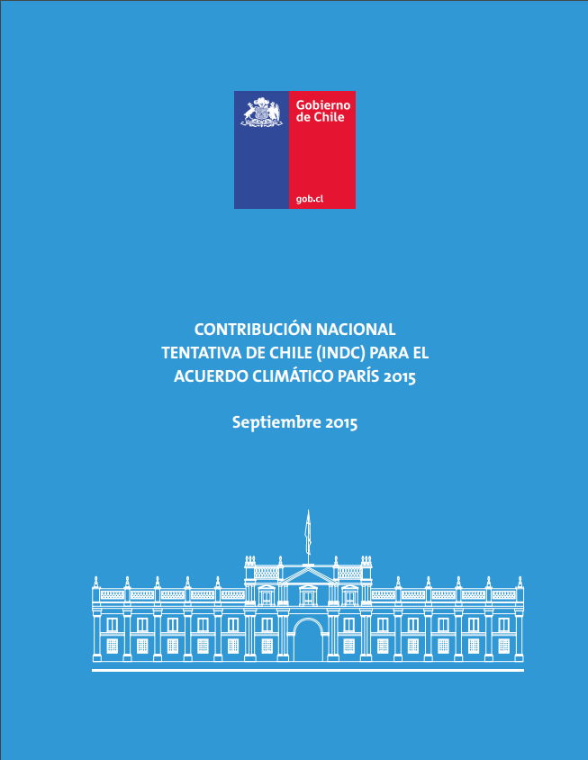
3 Pilares
Mitigación
Adaptación
Apoyo transversal para la acción climática
Creación de capacidades,
Transferencia tecnológica
Financiamiento
http://www4.unfccc.int/Submissions/INDC/Published%20Documents/Chile/1/Chile%20INDC%20FINAL.pdf

Slide 19



Contribución Nacional Determinada de Chile en Materia de Mitigación (INDC)
Meta Intensidad de Emisiones
Chile se compromete al 2030, a reducir sus emisiones de CO₂ por unidad de PIB en un 30 % con respecto al nivel alcanzado en 2007, considerando un crecimiento económico futuro que le permita implementar las medidas adecuadas para alcanzar este compromiso*.
Adicionalmente, y condicionado a la obtención de aportes internacionales, el país se compromete al 2030, a aumentar su reducción de emisiones de CO₂ por unidad de PIB hasta alcanzar una disminución entre 35 % a 45 % con respecto al nivel alcanzado en 2007, considerando, a la vez, un crecimiento económico futuro que le permita implementar las medidas adecuadas para alcanzar este compromiso.
1
2

Slide 20
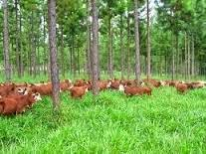

Compromisos sector silvoagropecuario
Contribución Nacional Determinada (INDC)
Compromiso de reducción de emisiones asociado al sector Uso de la Tierra, Cambio de Uso de la Tierra y Silvicultura (UTCUTS). Contempla acciones de manejo forestal sustentable en 100.000 hectáreas de bosque nativo y la forestación, principalmente con especies nativas de 100.000 hectáreas, metas que se deberían concretar al año 2030.

Slide 21
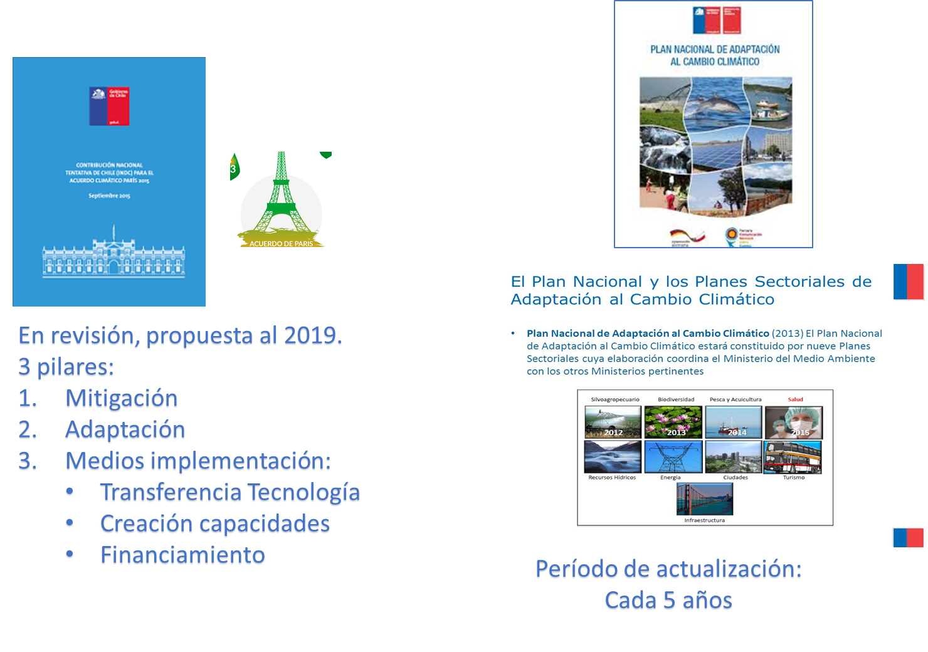

COMPROMISOS Y ACTUALIZACIONES PILAR ADAPTACIÖN
Planes sectoriales de adaptación: silvoagropecuario, biodiversidad, recursos hídricos, pesca y acuicultura, salud, energía, infraestructura, ciudades y turismo, prioridades de Chile en materia de adaptación
Decreto Nº30, del Ministerio de Relaciones Exteriores. Ratificación del Congreso Nacional.
http://bcn.cl/20ory

Slide 22
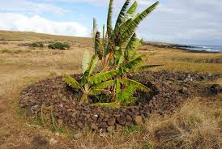
Contribución Nacional Determinada de Chile en Materia de Adaptación (INDC)
Dos diferentes ciclos: el primero que finalizará en 2021
Manavai. Isla de Pascua
Disponer de las herramientas para enfrentar los impactos del Cambio Climático al 2021
Implementación acciones concretas para incrementar resiliencia en el país, en el marco del Plan Nacional de Adaptación al Cambio Climático y de los planes sectoriales, con una perspectiva descentralizada y buscando la integración de los esfuerzos entre los distintos niveles de decisión (nacional, regional, municipal).
- Identificación de fuentes de financiamiento para implementar dichos planes
- Creación de sinergias con las iniciativas que se contemplen en materia de mitigación, y
maximizar los beneficios provenientes de los pilares de desarrollo y construcción de
capacidades y de creación y transferencias de tecnologías incluidos en esta contribución.
Preparación de métricas y mecanismos de medición de los planes sectoriales.

Slide 23
Contribución Nacional Determinada de Chile en Materia de Adaptación (INDC)
Dos diferentes ciclos: el segundo que finalizará en 2030
Manavai. Isla de Pascua
A partir del año 2021, Chile tiene como propósito:
Iniciar un segundo ciclo de planes sectoriales de adaptación al Cambio Climático, sobre la base de la experiencia obtenida a la fecha.
Contar con un Plan Nacional de Adaptación actualizado.
Desarrollar un ejercicio de evaluación nacional al 2026, a través de indicadores de vulnerabilidad y metodologías para determinar el aumento de la capacidad adaptativa de las personas, las comunidades y los sistemas que serán impactados por el Cambio Climático.

Slide 24
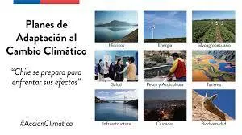
PANCC
16 objetivos específicos, 30 líneas de acción y 96 medidas
Cuatro ejes de acción: adaptación, mitigación, medios de implementación y gestión del Cambio Climático a nivel regional y comunal
Principales medidas: elaboración de nueve planes sectoriales de adaptación al cambio climático.
Se reforzará la red de estaciones de monitoreo de la Dirección Meteorológica de Chile
Se generarán mapas de vulnerabilidad climática, para apoyar toma de decisiones en los territorios.

Slide 25
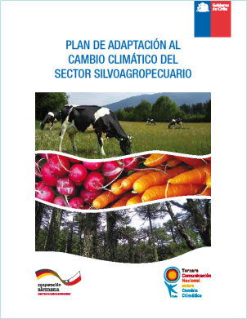
Plan de Adaptación Nacional al Cambio Climático del Sector Silvoagropecuario
1 y 2
Competitividad
Investigación e innovación
3 y 4
Sustentabilidad económica, social y ambiental
Transparencia y acceso a mercados
5
Modernización del Ministerio y sus Servicios
IMPLEMENTACIÓN
Ejes estratégicos
Ministeriales
Metas y acciones
Cobertura, presupuesto asociado
Plazos, participantes y responsables
21
medidas
Publicación 2013-2018
MINAGRI
FIA, FUCOA,SAG, INDAP, UNEA, INFOR, CONAF, ODEPA, CNR, CIREN, Subsecretaría MINAGRI, AGROSEGUROS, INIA

Slide 26
Actualización Plan de Adaptación al cambio climático del sector silvoagropecuario

Slide 27
ORIENTACIONES
Autocrítico (brechas plan SAP I): medidas cumplibles y medibles
Coherencia PP, lineamientos MINAGRI y compromisos país
Medidas y acciones sólo CC. Escenarios e información base
Directrices nacionales e internacionales para PANC
Fortalecimiento institucionalidad +3 pilares (adaptación con co-beneficios?)
Participativo (género y consideraciones indígenas)
Distintos Niveles y escalas de acción
MRV: indicadores: seguimiento, cumplimiento e impacto
Zonas intermedias (agroforestales)
Otras temáticas a considerar: género y pueblos originarios
1 Medida: Plan regional (Aysén)
Medidas a corto, mediano y largo plazo

Slide 28
Gracias
J.Angelina Espinoza O.
jespinoz@odepa.gob.cl
Especialista encargada de cambio climático
ODEPA

Slide 29
Políticas y compromisos CC en Chile y MINAGRI
Mitigación y adaptación
Estrategias nacionales de cambio climático y lineamientos MINAGRI
Compromisos internacionales (CMNUCC)
Pre-2020 (NAMAs)
NAMA Forestal (ENCCRV 2012-2020)
NDC
(Post 2020)
Mitigación (Forestal)
Adaptación (Plan SAP, plataforma)
Construcción y fortalecimiento Capac.
Desarrollo y transf. de tecnologías
Financiamiento
Plan Acción nacional de CC (2008-2012) y en actualización (2017-2022)
Plan adaptación nacional de CC (Dic 2014)
Planes sectoriales
SAP
2013-2017
21 medidas
Biodiversidad
2014
50/23 medidas
Pesca
…2015
6 +
2017
ENCCRV
Inventario

Slide 30
NDC implementation case study:
Looking for transformation by reducing emissions intensity in climate-smart beef production agroecosystems in Uruguay
Carolina Bailán
Ministry of Livestock, Agriculture and Fishery- Uruguay
December 6th, 2018
COP 24

Slide 31
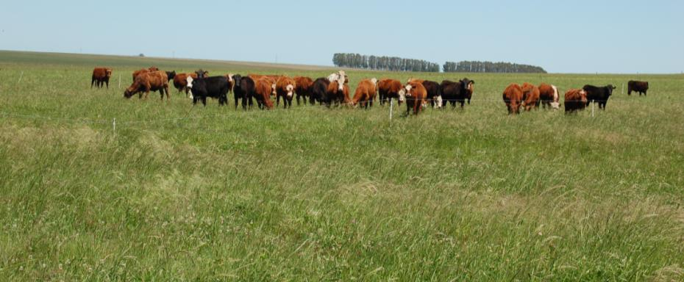
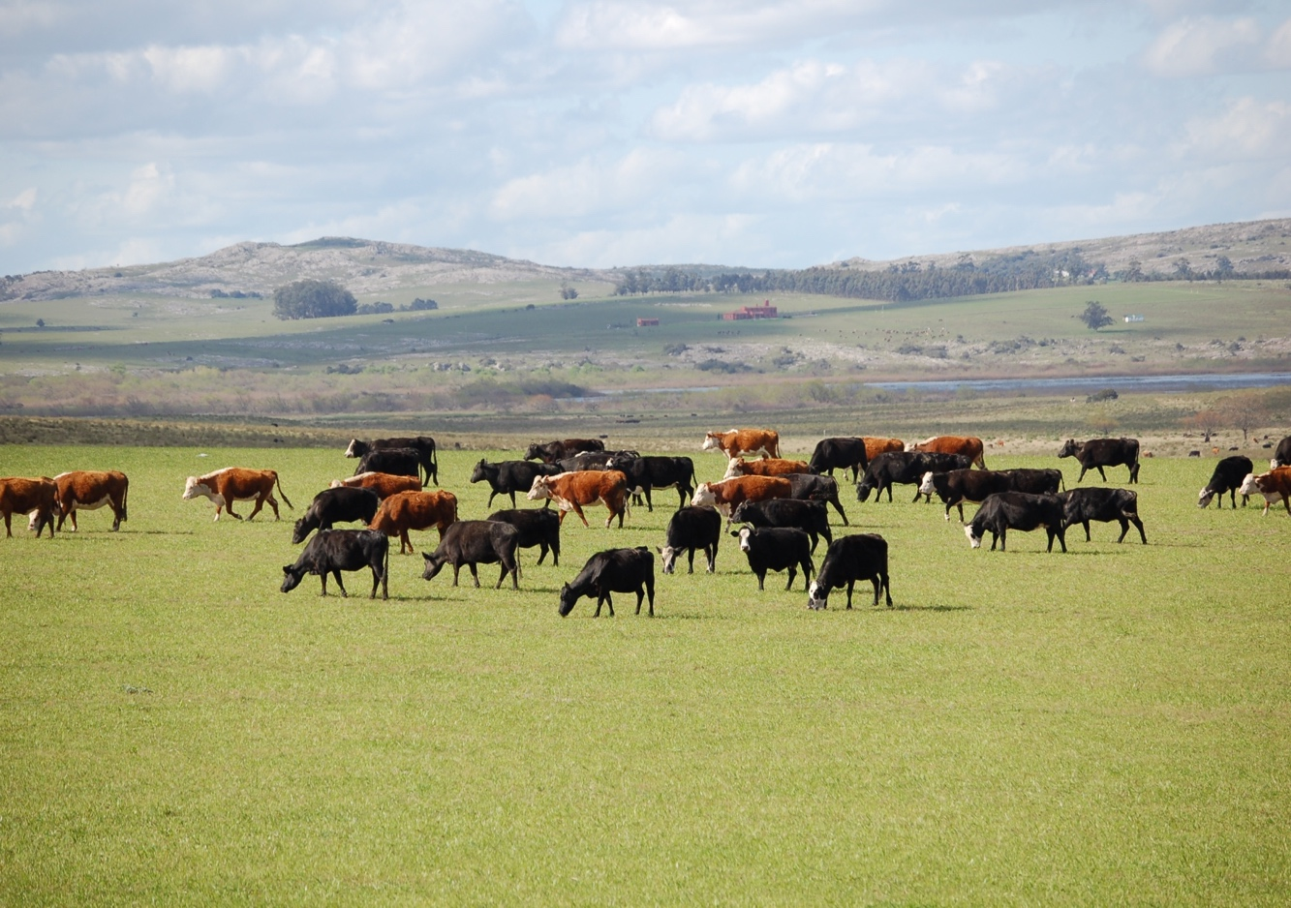
Uruguay is a livestock country with an economy strongly based on the agricultural sector (70% of all exports).

Slide 32
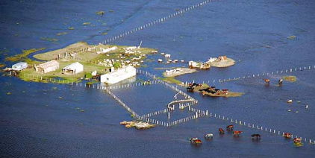
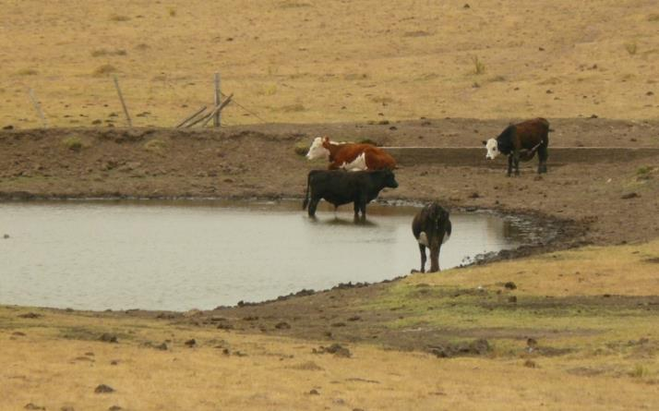
Context: simultaneous targets have to be achieved
More food.
2. Less environmental footprint.
3. Mitigation and adaptation of / to CC.

Slide 33
Uruguay’s national agricultural policies have defined adaptation and mitigation as key priorities and this is reflected in the Nationally Determined Contribution (NDC).
The livestock sector (beef and dairy) is very sensitive to climate change, and in particular to droughts, as the nutritional base are the natural grasslands and their productivity depends on rainfall.
The agriculture sector accounts for 73% of national GHG emissions in Uruguay. In particular, the livestock sector is responsible for 86% of total methane emissions and 93% of the agriculture sector emissions.

Slide 34
Mitigation in Uruguay´s NDC

Slide 35
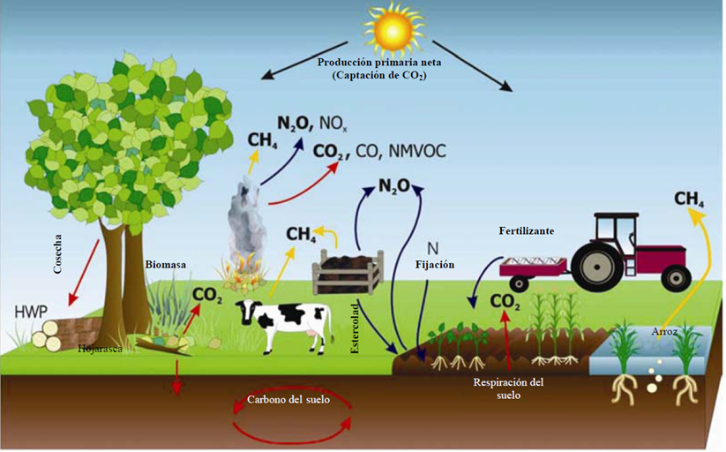
Many sources and sinks associated to Agriculture and land use/change

Slide 36
Potential opportunities to reduce emissions intensity and enhance sinks by increasing productivity and efficiency
Beef production
Manure management
Increase / maintain soil organic carbon
AWD in rice to avoid methane emissions
Afforestation and agrosilvopastoral systems
Increase the area of native forests for ecosystem services

Slide 37
We have identified several opportunities for synergies among productivity, adaptation and mitigation
The NDC of Uruguay to 2025 is very ambitious and explicit in the AFOLU sector

Slide 38
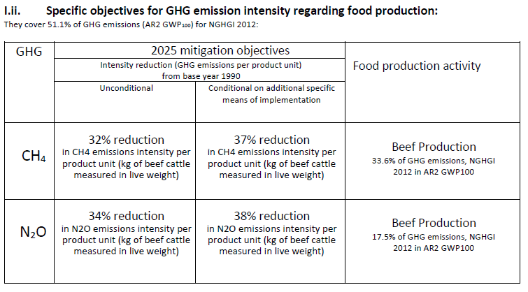

Slide 39
HOW DO WE EXPECT TO REDUCE EMISSIONS INTENSITY?
Ei = Gross Emissions / Kg
Stabilize Gross Emissions
Increase beef productivity mainly through:
a) improved diet (+ digestibility)
b) reduced breeding overhead
c) increase overall herd efficiency (+extraction rate - age at first mating - slaughter age, etc.)

Slide 40
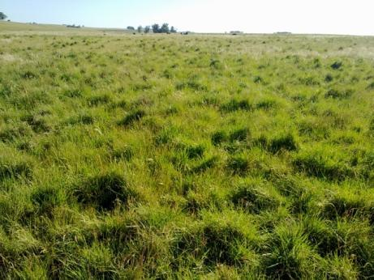
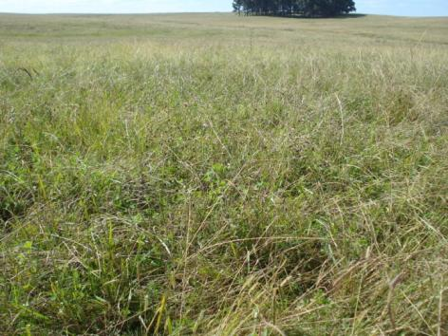





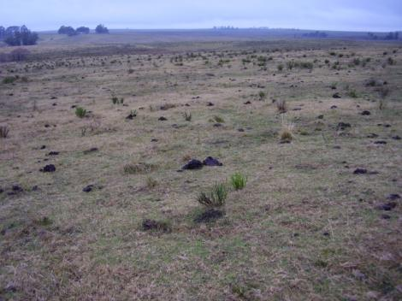
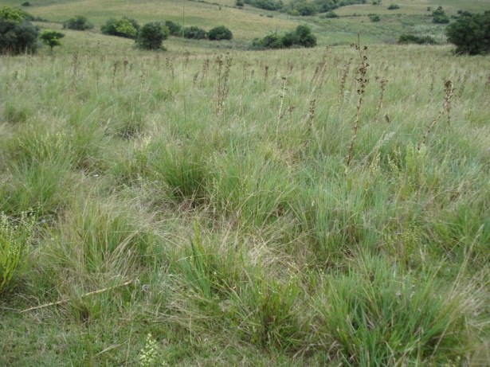
Sharp increase in grass and beef production managing stocking rate
Less SOC
Rebuilding SOC

Slide 41
Target 2: Enhance silvopastoral systems
Sequester 400 kton de CO₂ yearly in 10.000 ha of samall forests for shadow and shelter + 10.000 ha of silvopastoral systems.

Slide 42
Target 3: Cero deforestation / increase in native forest areas
(Δ beef production by Δ productivity with no land use change)
Without /MOI: Maintain 854.000 ha de bosques nativos.
With MOI: Increase native forests area by 5 %

Slide 43
4. Cropland: maintain SOC stocks (2025)
5. Croplands: avoided emissions of N₂O (2025)
6. Well managed rangelands: maintain SOC stocks + potential for sequestration (2025).
7. Rice: AWD to reduce methane emissions
8. Manure management in dairy farms: avoided emissions of methane (2025).
Notes:
[Se estima que en promedio se ganará C a una tasa anual esperada de 0,2 ton C año⁻¹. Se espera secuestrar 0,55 Mton de CO₂.] Se puede cuantificar lo evitado de emiir.

Slide 44
Challenges for MRV of NDC targets in AFOLU in Uruguay

Slide 45
Improve the GHG inventory (T, A, C, C, C = Transparency, Accuracy, Completness, Consistency & Comparability)
Tier 2 EFs and parameters are needed.
Because: a) default (Tier1) EFs from IPCC tables may have high uncertainties and b) they don ´t capture changes due to adoption of better practices. They are not adequate track progress in the NDC´s targets.
Good quality activity data is another huge challenge for a transparent and accurate MRV of NDC targets.
In short: it is key to improve the statistical systems and to continue developing Tier 2 or Tier 3 Efs for Key Categories.

Slide 46
Finally:
Our NDC also includes diverse actions related to adaptation, which is a strategic for Uruguay and is part of our NAP (no details here, but e.g. more soil organic carbon is a benefit for adaptation).
And it is interesting to highlight that several mitigation actions are synergic with adaptation and with increase in productivity.

Slide 47
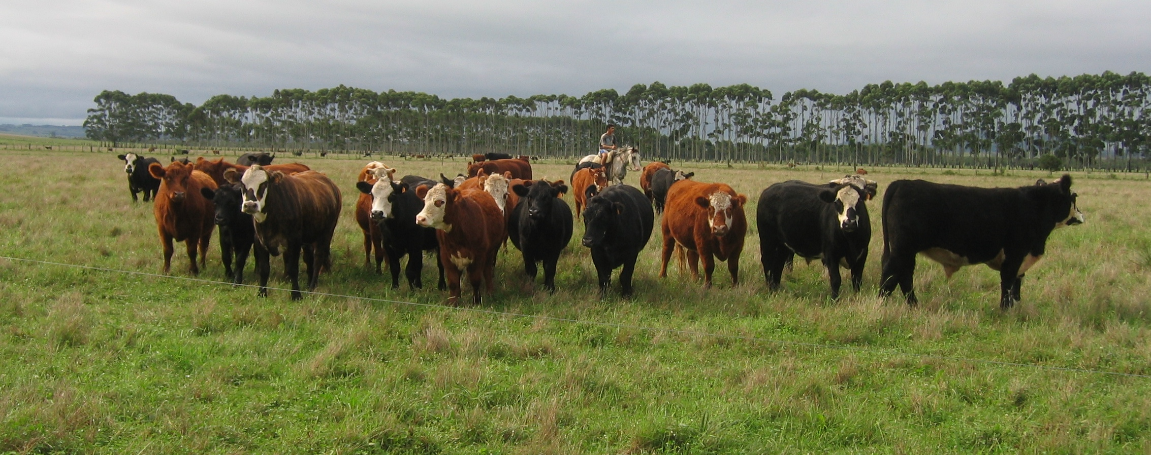
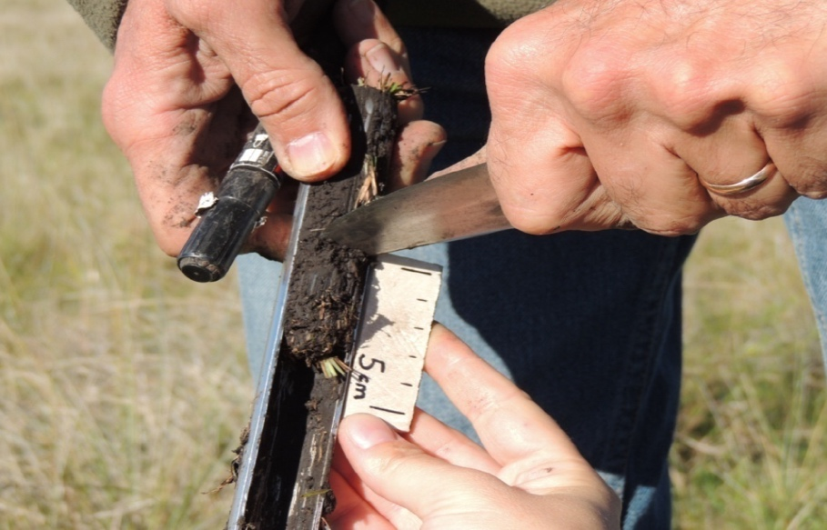
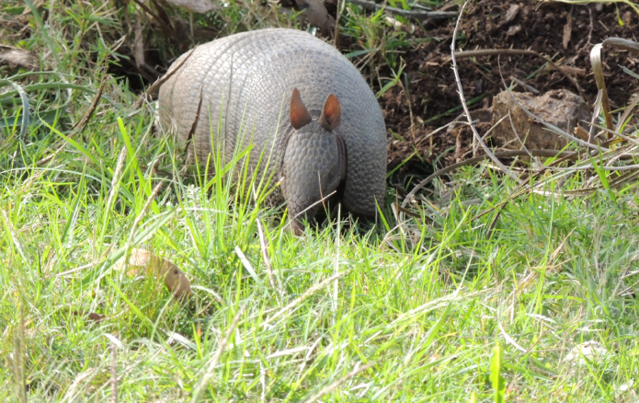
Thank you!

Slide 48

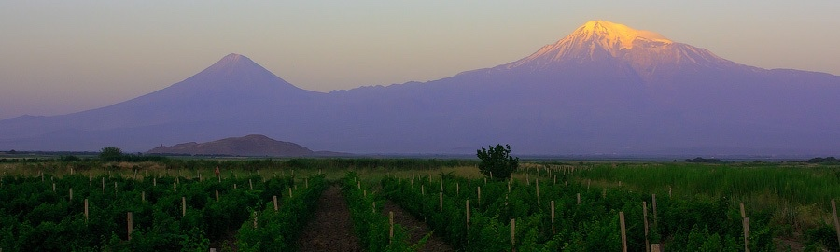
Agriculture Sector in Armenia’s Nationally Determined Contributions
Ministry of Nature Protection
of the Republic of Armenia
IFPRI / Cornell / CCAFS Side Event, COP 24 in Katowice, Poland
December 4, 2018
Diana Harutyunyan
UNDP Climate Change Programme Coordinator

Slide 49
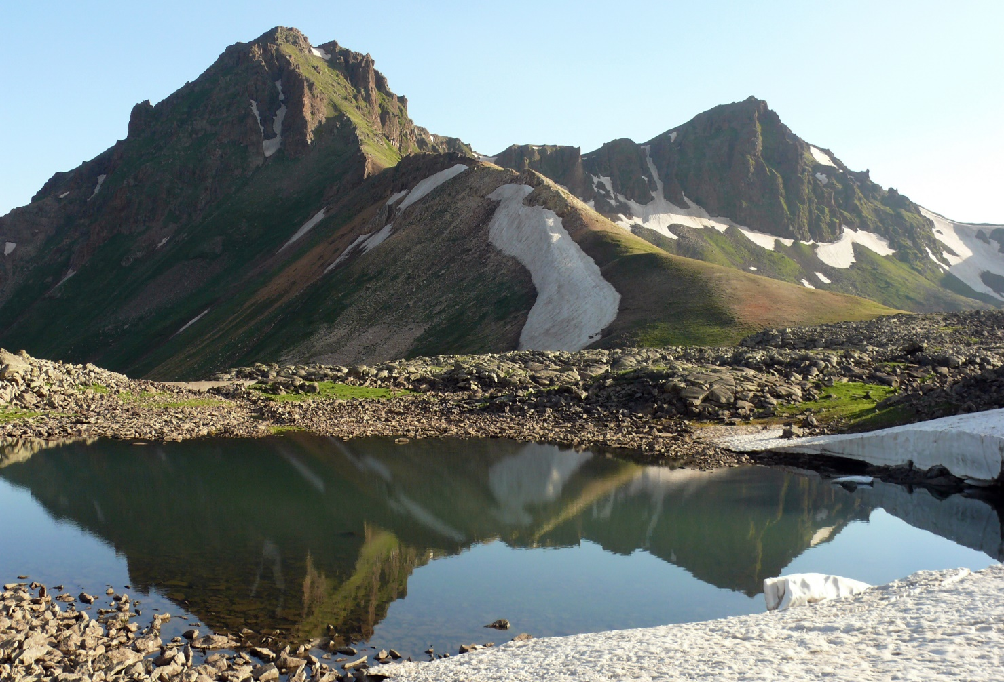
Armenia: Country Profile
Population ~ 2.92mln
Land-locked, mountainous country
Altitude – 650m – 4095m
Climate: dry subtropical – to frosty highlands
Average annual temperature: +5.5⁰ C
Recorded highest temperature: 43,7⁰C
Recorded lowest temperature: -42⁰C
Precipitation annual: 592 mm
Driest regions – 200-250mm
Highlands – 800-1200mm
Agriculture:
44% work force employed
contributed 21% country’s GDP

Slide 50
Nationally Determined Contributions of Armenia under Paris Agreement
INDC is approved by Government Protocol Decision No 41, (10 September 2015) and it:
“strives to achieve ecosystem neutral GHG emissions in 2050 (2.07 tons/per capita annual) with the support of adequate (necessary and sufficient) international financial, technological and capacity building assistance”.
“apply an ecosystem-based approach to mitigation and adaptation actions, giving preference to balanced and combined actions.”
Agriculture sector is mentioned for its potential in mitigation as well as key sector for adaptation policy implementation.

Slide 51
Climate Change Regulatory Framework in Armenia
The Inter-Agency Coordinating Council established by the order of Prime Minister (2012) comprised of 14 ministries, two state agencies and chaired by the Minister of Nature Protection is main body for inter-sectoral coordination of implementation of UNFCCC in Armenia
The obligations of the Council in particular include coordination of:
activities aimed at the fulfilment of obligations under Convention and evaluation of implementation;
preparation and verification of National Communications and Biennial Reports.
For each 5 year period the priority measures for implementation of Convention are identified and approved by the Government Decree, the latest approved By Decree #49 for 2016-2020 period
Notes:
The Council is comprised of 14 ministries, two state agencies, the Armenian Public Services Regulatory Commission, the Armenian National Academy of Sciences, and the UNFCCC National Focal Point. It is supported by an inter-agency working group. The Council´s tasks include the adoption of a national plan for adaptation.

Slide 52
Agriculture sector contribution to GHG emissions, 2014
Agriculture sector accounted for 19.56% of Armenia’s total greenhouse gas emissions in 2014.
Share of emissions sources in Agriculture sector:
59% - enteric fermentation
12% - manure management
29 % - managed lands.
The share of emissions from the biomass burning and from urea application is negligible.
Emissions in the Agriculture sub-sector decreased by 2.79 per cent during 1990–2014.

Slide 53
Most vulnerable sectors to climate change, for priority adaptation activities according to Armenia’s NDC, 2015
Natural ecosystems (aquatic and terrestrial, including forest ecosystems, biodiversity and land cover)
Human health
Water resource management
Agriculture, including fishery and forests
Energy
Human settlements and infrastructures
Tourism

Slide 54
National strategic documents and climate change adaptation
Strategic Program of Prospective Development 2014-2025, the main overarching development strategy of the country, mentions the need for addressing climate change in order to improve rates of economic growth
Agriculture Sector Sustainable Development Strategy (2010-2020)
National Security Strategy (2013) AND National Strategy on Disaster Risk Management (2017) integrates climate change related risk management including food security

Slide 55
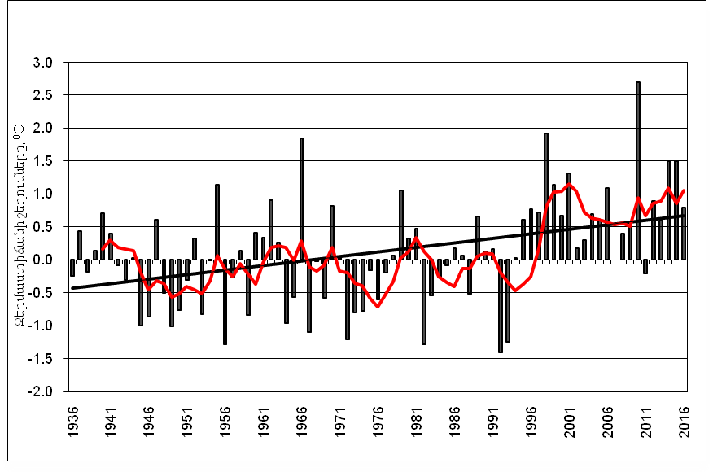
Annual average annual air temperature deviations in the territory of Armenia from average of 1961-1990
Source: Hydromet Service

Slide 56
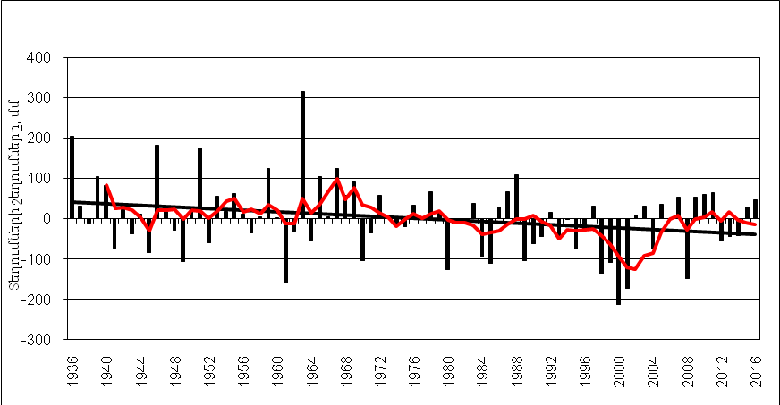
Annual average precipitation deviations in the territory of Armenia from average of 1961-1990
Source: Hydromet Service

Slide 57
The trends of atmosphere temperature (1929-2016) and precipitation (1935-2016) in Armenia
Period | Temperature, °C |  | Period | Precipitation, mm
1929-1996 | +0,4 |  | 1935-1996 | -35 (-6%)
1929-2007 | +0,85 |  | 1935-2007 | -41 (-7%)
1929-2012 | +1,03 |  | 1935-2012 | -59 (-10%)
1929-2016 | +1.23 |  | 1935-2016 | -50 (-9%)

Slide 58
Hazardous hydrometereological events dynamics in Armenia, 1970-2016
Frost Strong winds
Intense precipitations Hail
Source: Hydromet Service

Slide 59
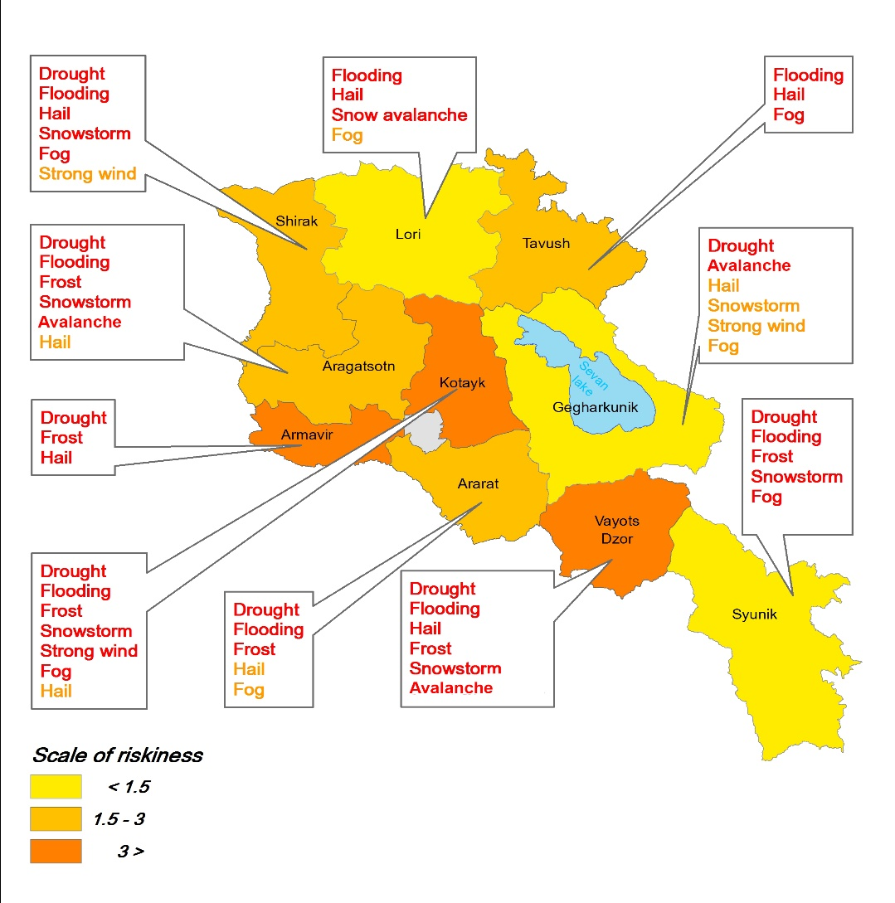
Agriculture Vulnerability to Hazardous Hydrometereological
Events by Regions
Year | Damage billion AM drams
1995 | 17.00
1996 | 12.59
1997 | 26.53
1998 | 14.95
1999 | 11.33
2000 | 59.78
2001 | 23.94
2002 | 15.14
2003 | 82.63
2009 | 11.89
2010 | 35.50
2011 | 0.91
2012 | 0.49
2013 | 23.92
 | 336.6
Source: 3rd National Communication

Slide 60
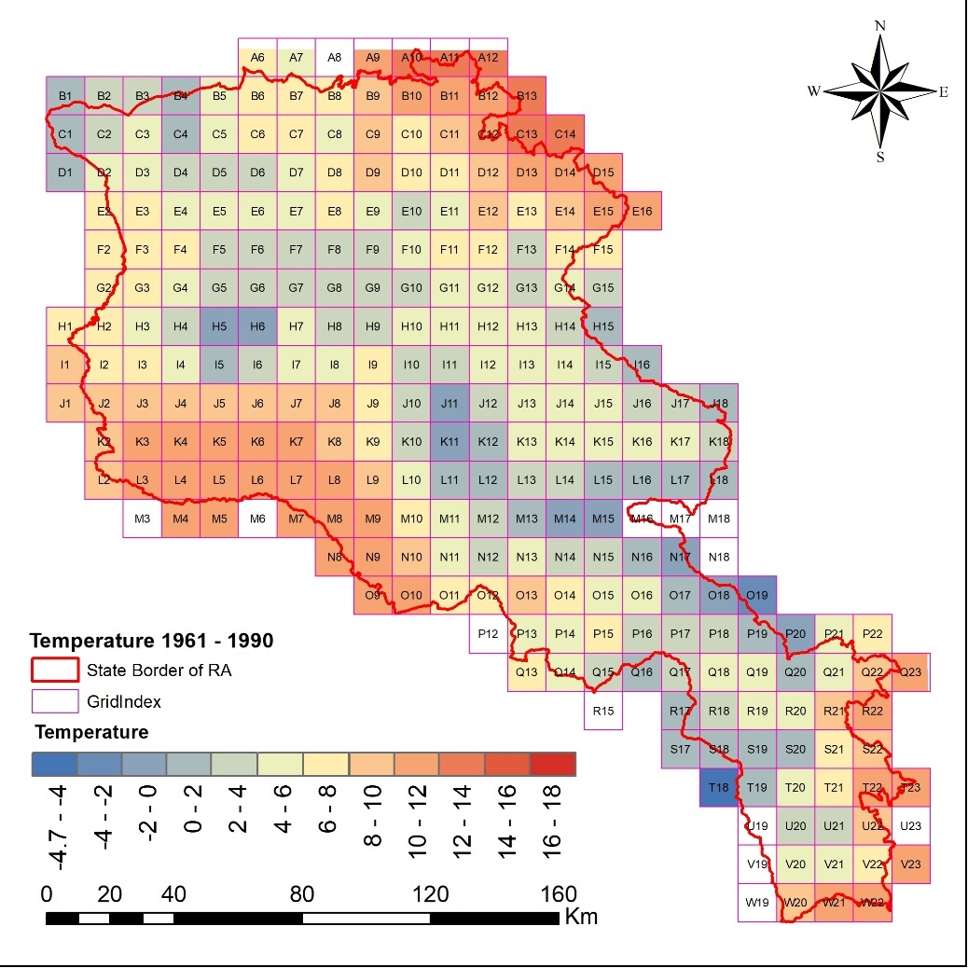
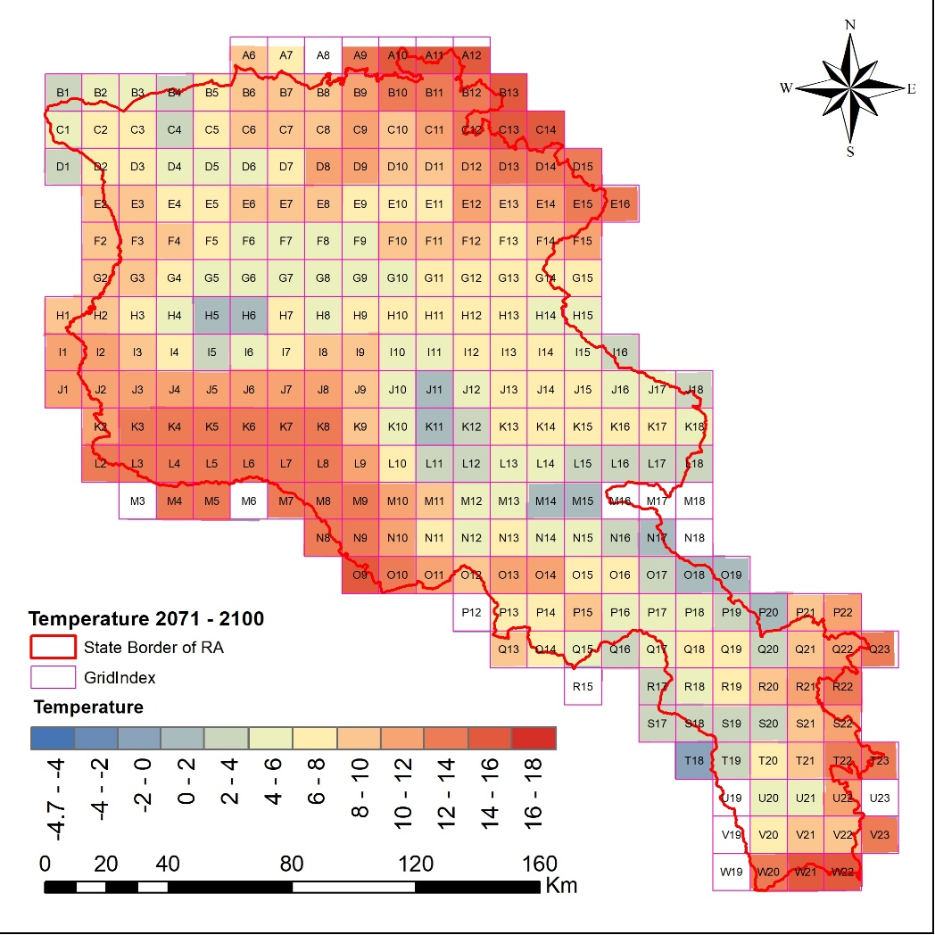
Climate change annual temperature forecast for Armenia
1961-1990
2071-2100
Source: Hydromet Service

Slide 61
Climate change in Armenia
Increasing of mean air temperature by 1.23⁰ C during 1935-2016
9% reduction of precipitations during 1935-2016
Reduction of crop yields and increase of losses from Intensification and increased frequency of extreme weather events,
Vertical shifting of agroclimatic zones
80% of agricultural lands already affected with desertification processes, climate aridity, landslides and flash floods will further impact land degradation
Rural and low-income households are particularly vulnerable to climate change negative impact – increasing migration, malnutrition, poverty

Slide 62
Agriculture Sector Adaptation Measures Prioritized under Armenia’s Climate Change Policy
Water Sector
Include the climate change factor in water management plans and consider while providing water-use permits
Expand and optimize the irrigation network, increase storage capacities in reservoirs, reduce losses in the water supply system, promote water saving technologies
Monitor the impact of CC on ground water resources,
Agriculture
Create risk-preventing infrastructures for agricultural producers, and support measures for reduction of agricultural outputs from climate variability (insurance, farmer’s cooperatives, diversification of businesses, early warning system government subsidies for promotion of advanced risk mitigation measures- anti-hail nets, construction of greenhouses, mechanisms for sustainable management of pastures),
Develop/strengthen the consultancy/advisory services, and access to new technologies

Slide 63
Key Barriers
Small farming plots – barrier for advanced agro-meliorative practices, technologies, machinery and finance:
Weak links between science and farmers
Agriculture statistics are not comprehensive, reliable and user friendly – barrier for policy development and introduction of insurance schemes
State support is more reactive than proactive - related to climate related risks management
Financial resources provided by banking sector are short term and with high interest rate –affordability issue due to current low economic productivity
Slow rate of new technologies and practices absorption – conservativeness of farmers, weak extension services

Slide 64
Opportunities for Adaptation
  Development partners are supporting agriculture sector modernization
  Government of Armenia prioritize food security and support to rural development:
    pilot project for introduction of the agricultural insurance
    subsidy schemes for promotion of introduction of anti-hail nets, drip irrigation, construction of greenhouses,
    support in establishing cooperatives
  Project “National Adaptation Plan to advance medium and long-term adaptation planning in Armenia “developed with support of UNDP was funded by Green Climate Fund Readiness Preparatory Programme (June 2018) – Agriculture sector as main vulnerable sector will be targeted for adaptation policy development.

Slide 65
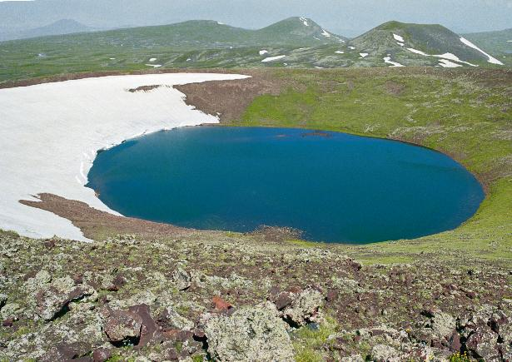
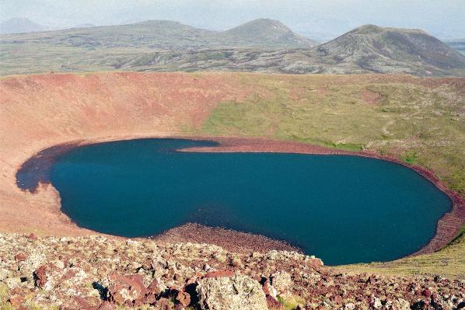
Ajdahak high mountain lake , h.s.l.3593m
August, 1984
August, 2008
www.nature-ic.am
diana.harutunyan@undp.org

Slide 66
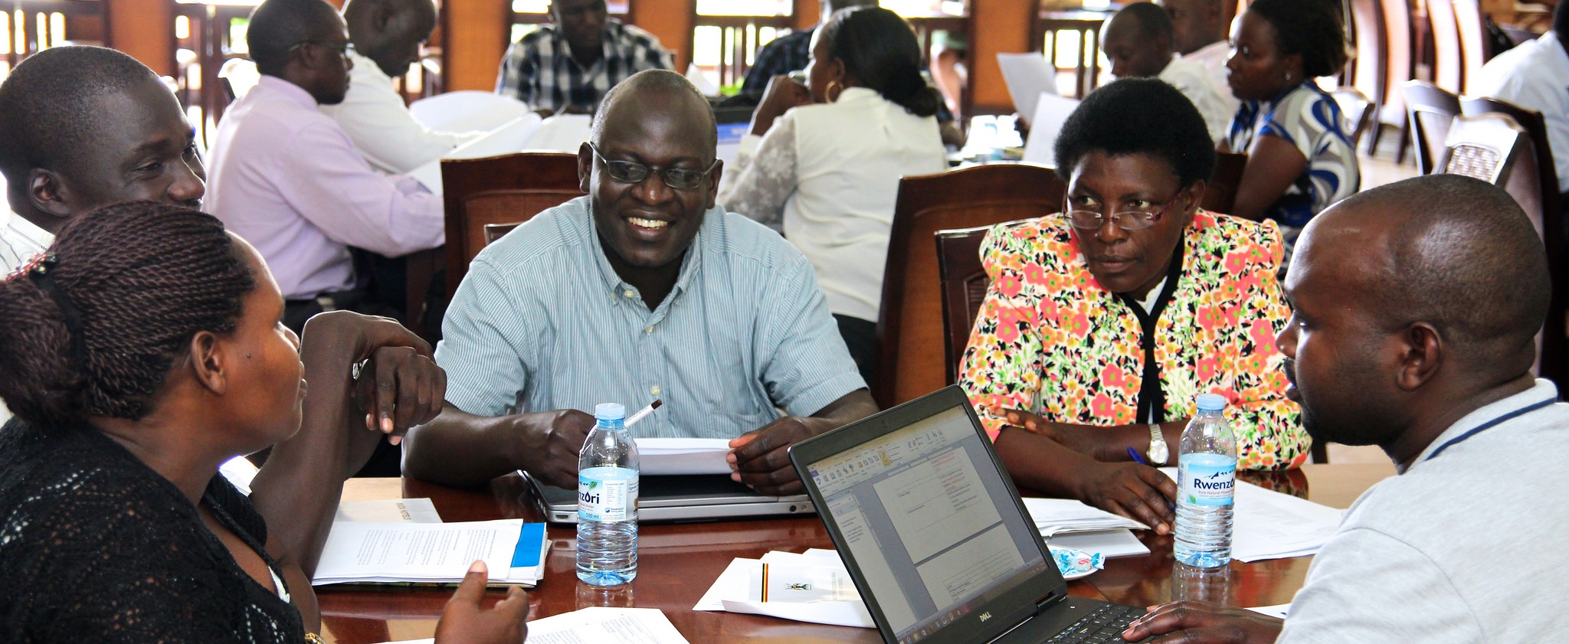
CCAFS Science-Policy Dialogue Platforms in East Africa
Catherine Mungai
Partnership & Policy Specialist

Slide 67
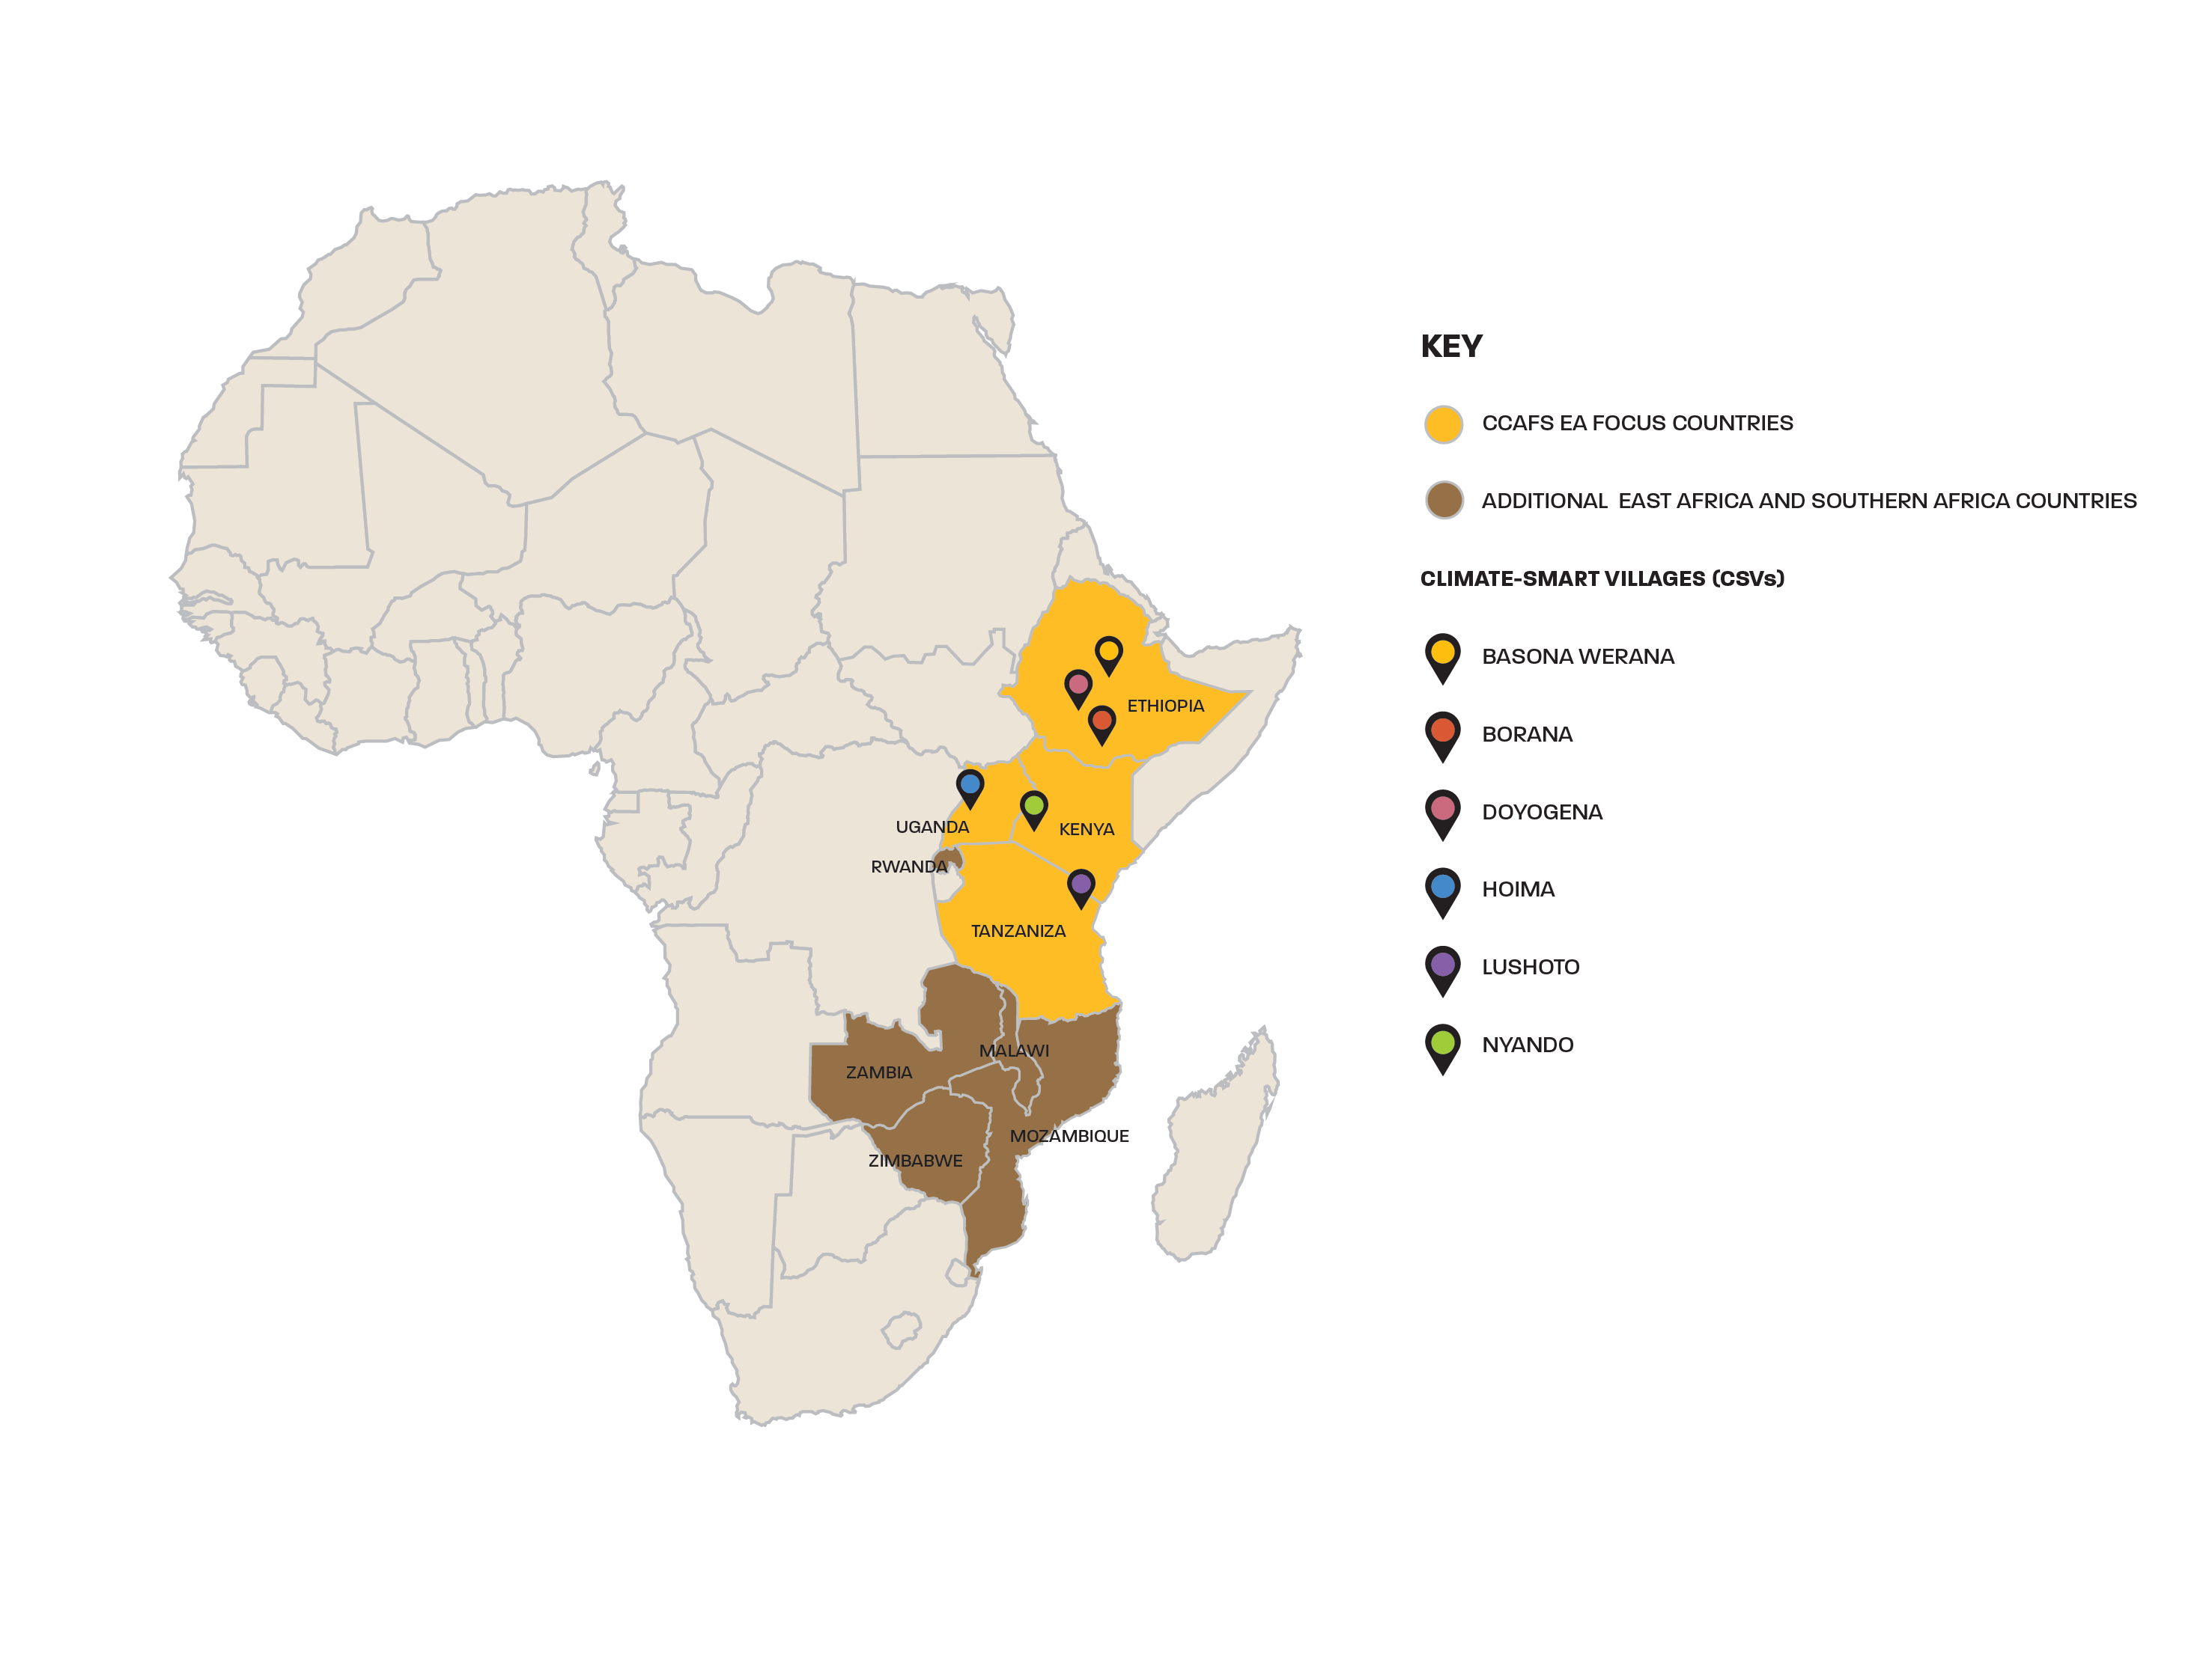
CCAFS East Africa focus countries and research sites
Established six research sites across ET, KE, UG and TZ
Selection based on farming systems and risk profile, climatic, major agro-ecological, environmental and socio-economic challenges and livelihoods

Slide 68
Policies, strategies and priority actions in EA
Kenya | Tanzania | Uganda | Ethiopia
National Climate Change Action plan (2013–2017, under review) | National Climate Change Strategy (2012) | National Climate Change Policy (2013) | Climate Resilient Green Economy Strategy (2011) Climate Resilience Strategy for Agriculture and Forestry (2011)
Climate Change Bill (2014) National Climate Change Act and Policy (2016) | National Climate Change Finance Analysis (2013) | National Adaptation Programme of Action (2007) | National Adaptation Programme of Action (2007) National Adaptation Plan (2017)
National Climate Change Response Strategy (2010) Kenya National Adaptation Plan (2015-2030) | National Climate Change Communication Strategy (2012–2017) | Climate Change Costed Implementation Strategy (2013) | National Policy and Strategy on Disaster Risk Management (2013)
Climate Finance Policy (2017) Climate smart agriculture Strategy (2017–2026) Climate smart agriculture implementation framework (2018 -2027) | Agriculture Climate Resilient Plan (2014-2019) Climate smart agriculture program (2015–2025) | Disaster Risk Management – Climate Change Adaptation Communication Plan and Media Engagement Strategy (2013) National Agriculture Policy (2013) Climate smart agriculture program (2015-2025) | Climate Resilient Green Economy Strategy – Sector wise GTP II Implementation Monitoring 2018 National Disaster Risk Management Commission (2015) Agricultural Transformation Agency (2010 - present)
Nationally Determined Contributions (NDC, 2015) Nationally Appropriate Mitigation Actions (NAMAs – at various stages)

Slide 69
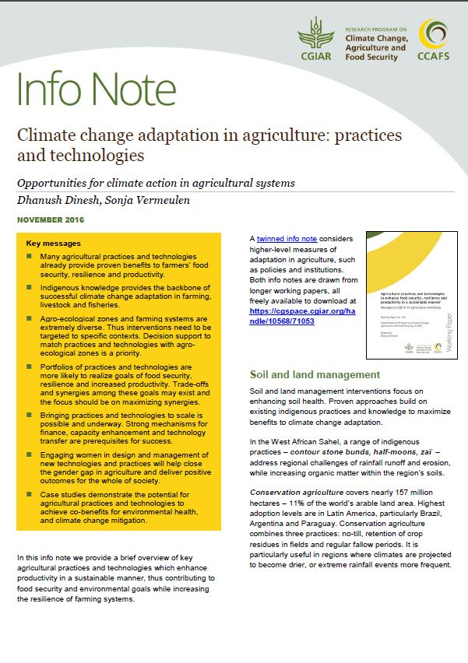
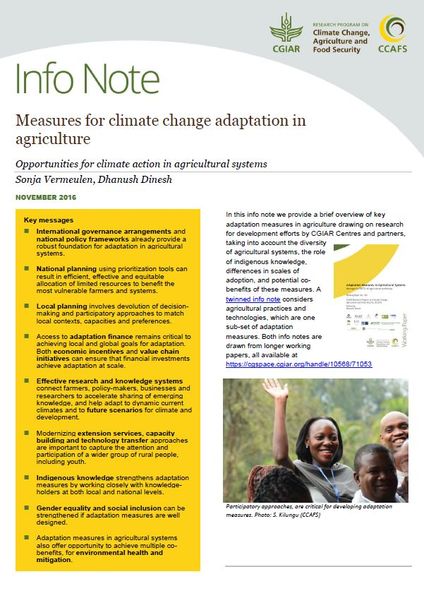
Science-policy support
Support to AGN to negotiate inclusion of agriculture within climate change discussions –SBSTA & COP;
Preparation of CSA framework programs (CSA-FP) in eastern (Kenya, Uganda and Tanzania) and southern Africa (Namibia and Botswana);
Climate Smart Villages (CSVs) as learning grounds for policy makers, media and other stakeholders;
CANA platform (www.canafrica.com) – knowledge management and sharing e.g. webinars.

Slide 70
CCAFS platforms
The Policy Action for Climate Change Adaptation (PACCA) project in Tanzania and Uganda
Main objective was to have more demand-led research and interaction between researchers and decision makers
Research evidence generated through:
  Analyzing policy formulation and implementation processes,
  Trade-off analysis,
  Future socio-economic and climate scenario development,
  Creating evidence-based gender awareness,
  Applied information economics.
The actors included relevant ministries and departments, including Agriculture, Environment and Finance departments, local governments, NGOs, media, civil society, the private sector and research organizations

Slide 71
Objectives of the platforms
Act as a space for co-learning
Provide a platform for knowledge and information exchange
Assist in joint development of tools and strategies
Create synergies and coordination
Facilitate climate change responses at the local level
Channel community priorities into national dialogue and policy
Special focus on gender responsiveness – e.g. recognition of gender responsive policy and budget implementation at district level in Uganda and Tanzania, and development of strategies to improve gender integration in climate change adaptation

Slide 72
Key successes in Tanzania and Uganda
Opportunity for Non-state actors (LA members) to officially participate in the review
Slide courtesy of Edidah Ampaire
Tanzania NEP
Community levels, Tz
Implemented by 5 non-project districts, Ug
Adopted by 4 partners on bilateral projects, Ug
Scaling of LAs
Agriculture Sector Strategic Plan Uganda
NAP-Ag
Non-state actors in LA demanded own review of ASSP & submitted position paper
Invited to participate in NAP-Ag
Influencing change in policies
6 District Local governments, Ug & Tz
Participatory local adaptation planning (tool)
Integrated climate change in five year district development plans
Ordinances
Climate change mainstreaming guidelines, MAAIF, Ug
National & district LAs participated in consultations & validation as a group
Targeted engagement e.g. Uganda Parliament; Tanzania Parliament & Water Commission
Participatory land use mapping has been pivotal for local adaptation planning
Learning Alliance: a wanted group for e.g. actor inclusion, content validation, information dissemination

Slide 73
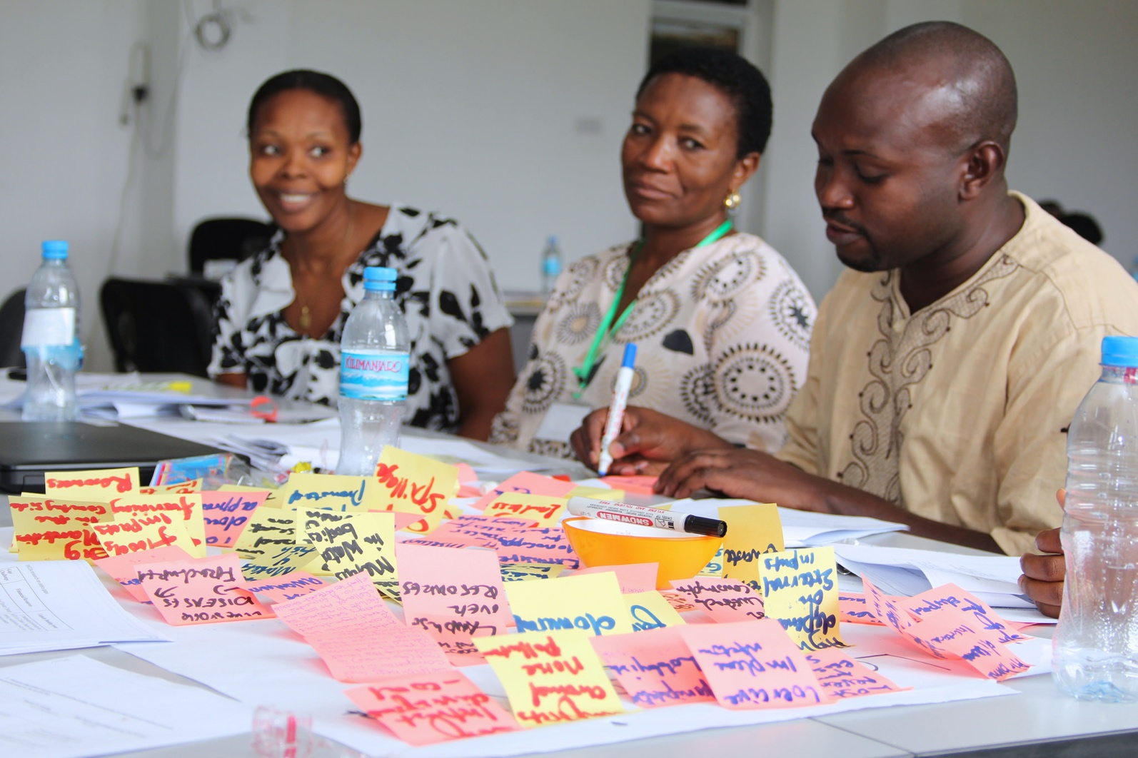
Challenges faced
Keeping momentum among members
Financing joint activities
Managing expectations at community level
Fostering successful learning processes
Translating science evidence into policy

Slide 74
Platforms as entry points for NDC/NAP implementation? Lessons learned
Institutionalize the platform in government structures
Link to value chain; important for private sector involvement
Have an interested champion/institution to keep momentum in space and time
Identify and address issues of common interest to stakeholders
Be inclusive in membership
Focus on tangible benefits, e.g. policy initiatives must link with initiatives that deliver
Focus on knowledge co-creation

Slide 75
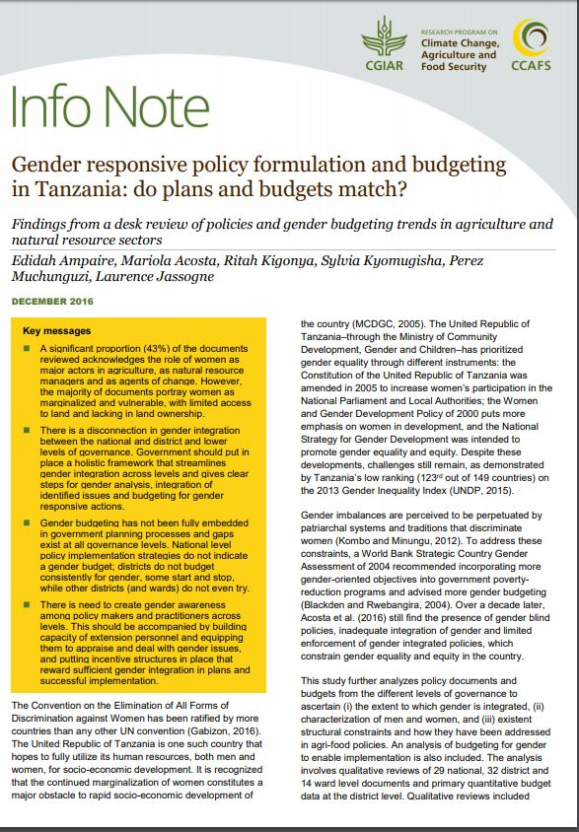
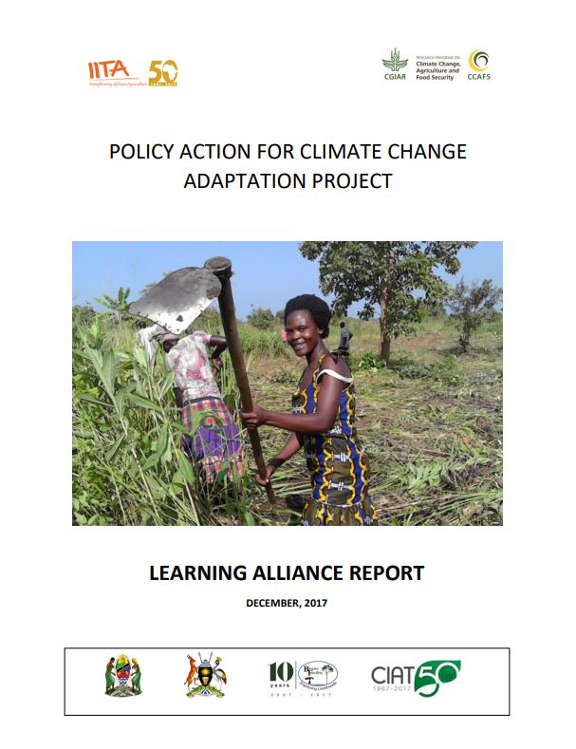
For more information
Info note: Gender and climate change in Uganda
Info note: Towards gender responsive policy formulation and budgeting in the agricultural sector: Opportunities and challenges in Uganda
Info note: Gender responsive policy formulation and budgeting in Tanzania
Info note: Barriers to successful climate change policy implementation in Tanzania
Info note: Scenario-guided policy planning in Uganda
Info note: Scenario-guided policy planning: Processes, comparisons and lessons from East Africa
Climate-smart agriculture report that includes analysis at farm level and national portfolio of options
Portfolio of present and future potential climate-smart agriculture investment options

Slide 76
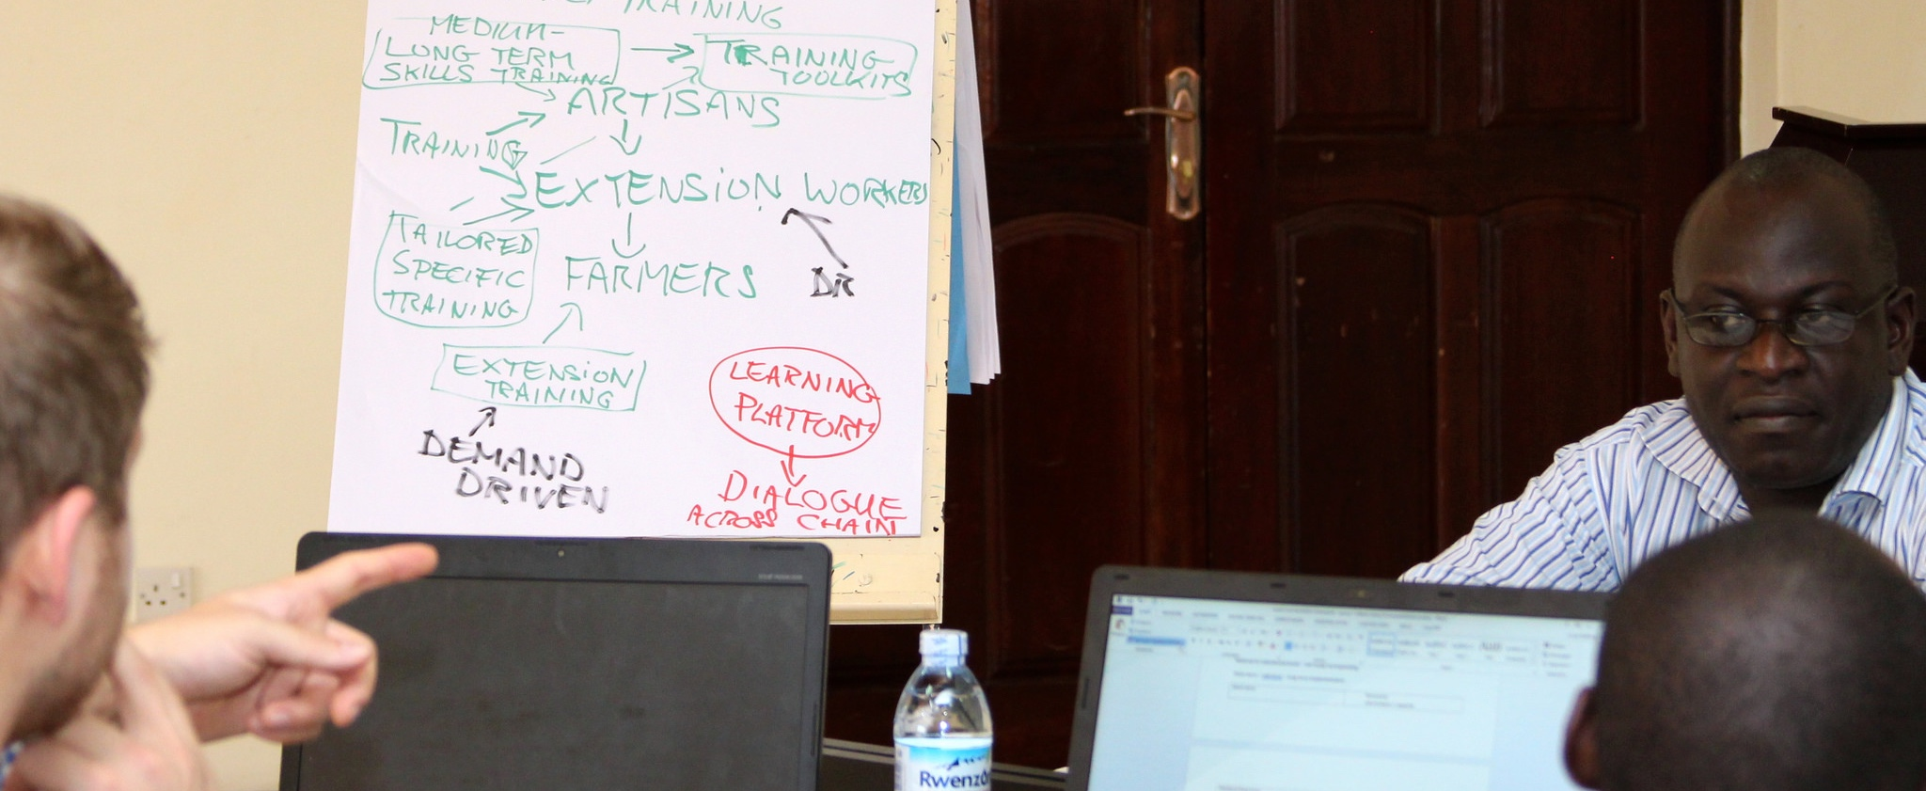


Thank you
Catherine Mungai, c.mungai@cgiar.org
Selected slides prepared together with Laura Cramer, l.cramer@cigar.org

Slide 77
Allison Chatrchyan, Cornell University, Ithaca, NY
Perspectives on Multi-level policy on agriculture and Country NDCs and Plans.
  Critical Question: How can we quickly scale up Climate Smart Agriculture in countries globally, when climate adaptation needs to be locally specific, but achieve global agreements?

Slide 78
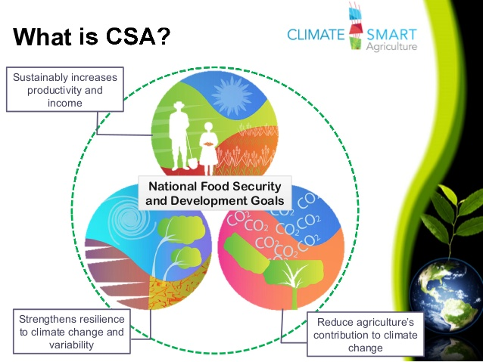

Slide 79
Polycentric Governance
for Climate Change
Elinor Ostrom:
If global environmental challenges are not backed up by a variety of efforts at the national, regional, and local level, they may not achieve the desired outcomes
Policy spans many spatial levels (international, national & local)
Many modes and domains of action (including policies, markets, networks)
More diverse, with a greater emphasis on bottom-up initiatives
Self organization, Site Specific, Experimentation and Learning, Trust
Greater # Actors, Greater Complexity, But Greater Innovation = Need for Coordination, Information Sharing
Notes:
The overall landscape of climate governance has become more “polycentric,” that is:

Slide 80
Global Policy Drivers:
  Paris Agreement: Of 162 INDCs, 104 included intentions to reduce emissions from agriculture, and 127 listed agriculture as a priority for adaptation.
  Koronivia Joint Work Program on Agriculture – key Questions
  2030 Agenda for Sustainable Development, and 17 Sustainable Development Goals (SDGs).
  But need to translate global goals into national policies !
  But agriculture adaptation is locally-driven: National Policy Makers need to listen to the needs of local communities and stakeholders
  Policy Coherence between the Global level, regional, national and local levels.

Slide 81
  But need to translate global goals into national and local policies!
  Agriculture adaptation is locally-specific: national policy makers need to include local communities and stakeholders in the process.
  Policy Coherence between the Global level, regional, national and local levels.

Slide 82
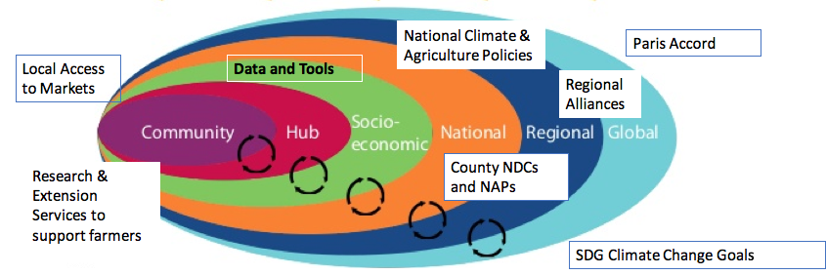
Nested Scales of Global to Local Policies for Transforming Agriculture within a Changing Climate

Slide 83
Key Needs
We know what to do! Political Will, Capacity
Support and Training for Extension or Agriculture Advisors on agriculture and climate change adaptation and mitigation
Funding!
Engage more stakeholders to make it real, translate science into policy: Farmers, NGOs, research universities
Capacity building for ALL developing and transition countries that include agriculture in their NDC
Specific project and policy templates that can be shared.
Precision Agriculture, decision support tools

Slide 84
Recent and Upcoming
Research/Policy Documents
Chatrchyan, A. C. Yin, E. Torquebiau, U.S. Nagothu. 2018. Multi-level policy measures to support sustainable agriculture intensification for smallholders. In Agricultural Development and Sustainable Intensification Technology and Policy Challenges in the Face of Climate Change. Ed. U.S. Nagathu. London: Routledge.
Transforming global food systems under a changing climate’ initiative led by the CGIAR Research Program on Climate Change, Agriculture and Food Security (CCAFS), the Danish Agriculture and Food Council (Landbrug & Fødevarer), and the University of Copenhagen: Policy Workstream – Coming 2019

Slide 85
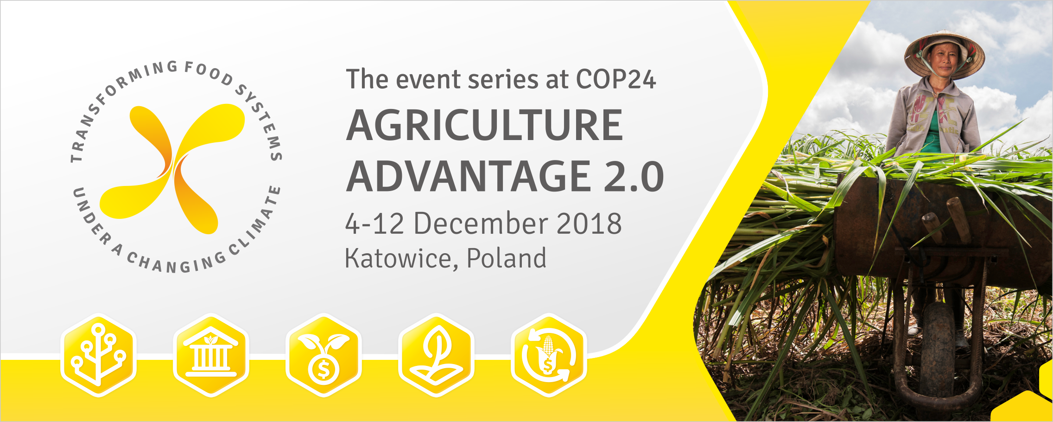

Slide 87
Questions and Discussion
Given what the scientific models can show us about climate impacts to crops, what kind of information would help policy makers develop adaptation policies for agriculture?
How can we facilitate better dialogue between policy makers and scientists?
How can we ensure better coordination between the broad goals of the Paris Agreement for climate change and agriculture, and national policy implementation?
For countries: what were the barriers to developing agriculture policies in NDCs and NAPs and what help is needed from which groups?

Slide 88
Thank you! Questions?
Carolina Balian: carolina.balian@undp.org
Allison Chatrchyan: amc256@cornell.edu
Angelina Espinoza: jespinoz@odepa.gob.cl
Diana Harutyunyan: diana@nature.am
Catherine Mungai: c.mungai@cgiar.org
Tim Thomas: Tim.Thomas@cgiar.org

